Slide 1
PDS CA2 Assignment
By:Sidharth Vinod (P1936252)

Slide 2
DATASETS
DATASETS USED
https://data.gov.sg/dataset/total-visitor-international-arrivals-to-singapore?resource_id=83063203-ff81-4764-a9dc-c4e209921fe7\
https://data.gov.sg/dataset/monthly-gazetted-hotel-statistics-by-hotel-tier?view_id=a2f15f7f-93d4-43e2-b389-a1d1c7da7534&resource_id=2c8d016c-d0e7-424d-8141-b828c9889b40
https://data.gov.sg/dataset/air-cargo-discharged-by-region-country-of-origin-monthly?resource_id=afe8d68e-60f8-434c-ab1a-255a67c635a0
Source:https://data.gov.sg/

Slide 3
Dataset 1:(Visitor International Arrivals to Singapore)
This dataset contains information about the total number of visitor international arrivals from the world to Singapore from 1978-2015
This Dataset contains 4 columns which are (month,region,country,no of visitor arrivals)

Slide 4
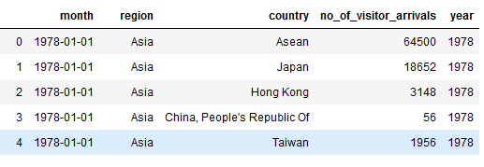

Data Manipulation
This dataset contained the data as months which is a large amount of values so i turned into years for ease of data analysis using the pd.to_datetime method

Slide 5
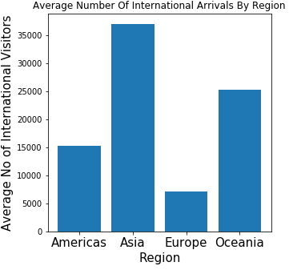
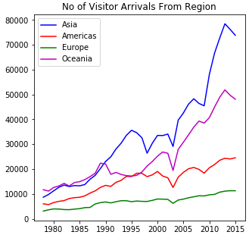
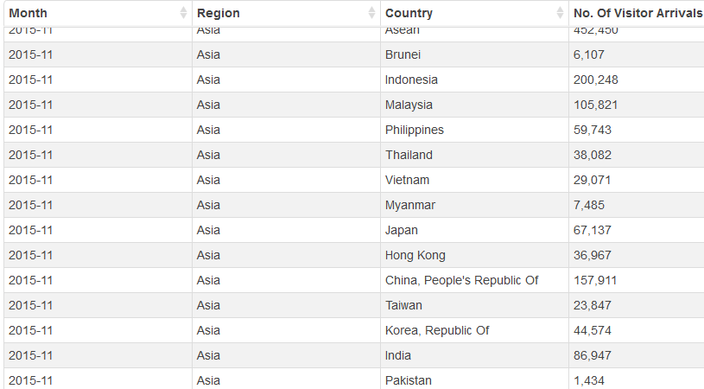
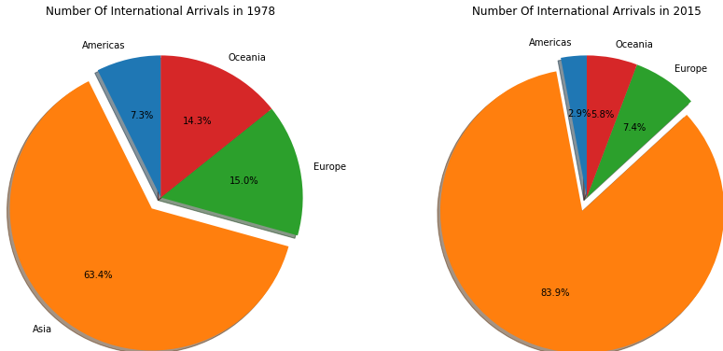
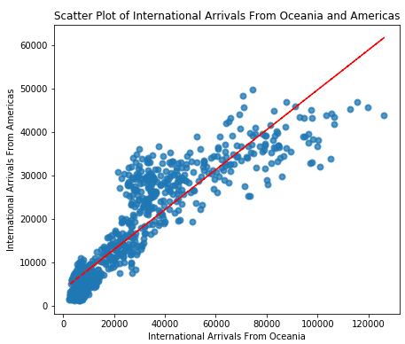
Processes
Planning of the data analysis of the Dataset and deciding on the graph that would best represent the Dataset.
Usage of Pandas Library to read the file and extract useful information on the dataset
Usage of the Matplotlib Library to generate the graphs

Slide 6
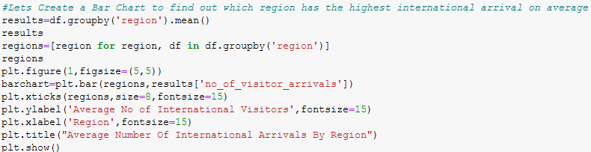
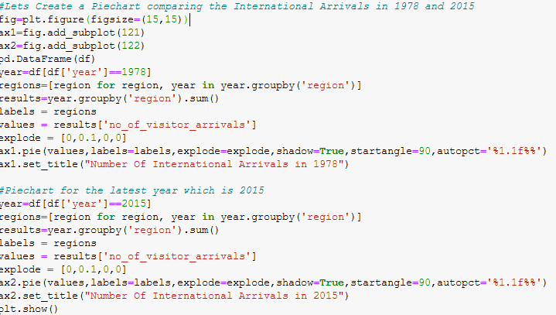
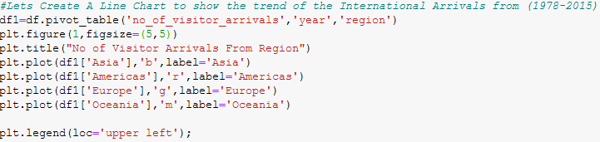
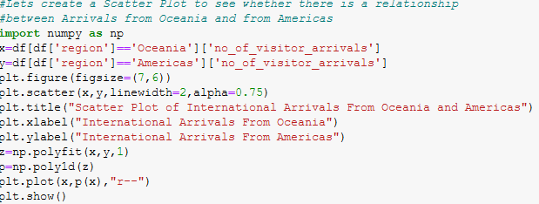
Code used

Slide 7
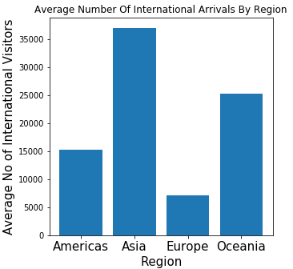
Insights
From the barchart,It can be seen that the Asia region has the highest number of Visitor Arrivals of 36979 arrivals and the lowest is from the Europe region with 7159
This is because of the close proximity of the Asian region to Singapore and the many close bilateral ties Singapore has with the countries in the Asian Region.An example of this is countries from ASEAN which singapore is an part of.Thus the high Visitor Arrivals compared to other region.

Slide 8
Insights
From the line chart,It can be seen that there is a sharp overall increase in visitor arrivals over the years from 1978-2015 from all regions
This is because of the rise of Singapore as an international tourist hub.This is because of Singapore’s expensive infrastructure and its low crime rate that makes it a ideal country to visit.

Slide 9

Insights
From the Pie Chart,It can be seen that percentage of Visitor Arrivals from Asia has increased by 20.5% and the Visitor Arrivals from the all the other region have decreased from 1978-2015
This increase in the percentage of Visitor Arrival can be explained by the emergence of the Asian Region and the importance it has to Singapore as a tourist destination

Slide 10
Insights
This Scatter Plot shows that there is a strong relationship between the increase in Visitor Arrivals from Oceania and the Visitor Arrivals from Americas
This tells me that as the number of Visitor Arrivals from Oceania increase the number of Visitor Arrivals from America also increases

Slide 11
Conclusion Of Dataset 1
It can be concluded that most of the visitor arrivals come from the asia region primarily to the fact of its close proximity and ties to singapore.This has caused the Asian region to rise above the other regions
It can also be concluded that there is a steady increase of Visitor Arrivals to Singapore from 1978-2015 because of the fact that Singapore is becoming more attractive to tourist because of its world class facilities and hospitality

Slide 12
Dataset 2:(Monthly Gazetted Hotel Statistics by Hotel Tier)
This dataset contains information of the standard average occupancy rate (AOR), standard average room rates (ARR) and revenue per available room (RevPAR) by hotel tier in Singapore
This Dataset contains columns which 5 columns which are (period,tier,aor,arr,RevPAR)
The housing tier system is developed by the STB to categorise hotels into tiers based on the combination of different factors such as average room rate and location.

Slide 13
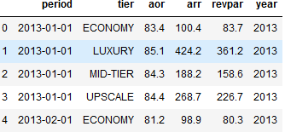

Data Manipulation
This dataset contained the data as months which is a large amount of values so i turned into years for ease of data analysis using the pd.to_datetime method

Slide 14
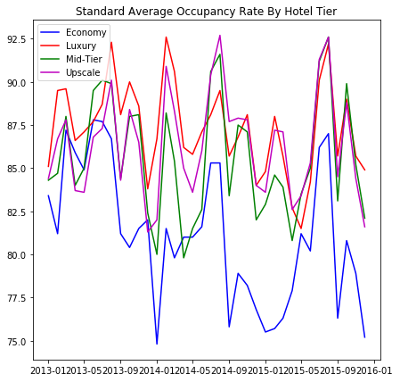
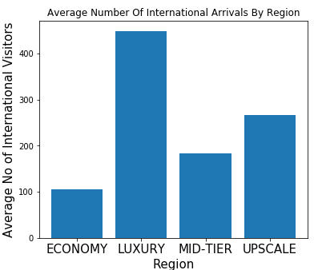
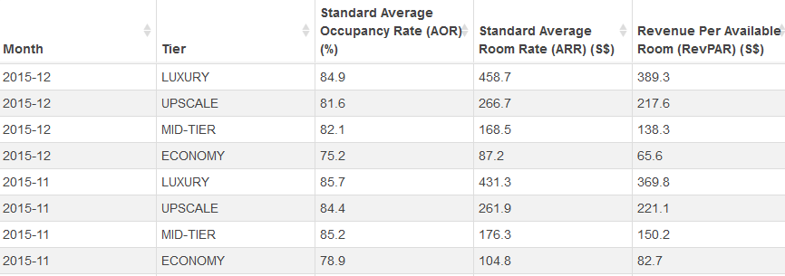
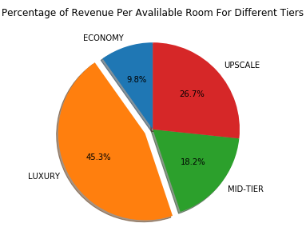
Processes
Planning of the data analysis of the Dataset and deciding on the graph that would best represent the Dataset.
Usage of Pandas Library to read the file and extract useful information on the dataset
Usage of the Matplotlib Library to generate the graphs

Slide 15
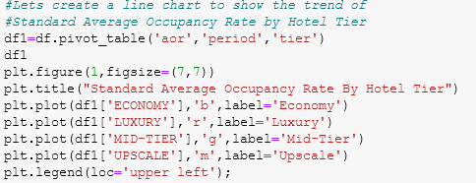
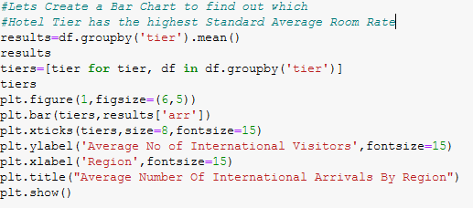
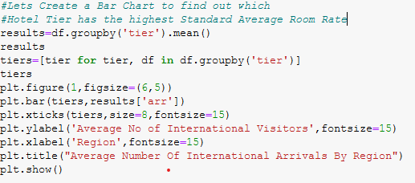
Code used

Slide 16
Insights
This line chart shows that the Standard Average Occupancy rate has been very volatile from the period of 2013-01 to 2016-01
It can be seen that the rate for all hotel tier seems to be the lowest in 2014-01,2014-09 to 2015-05 and 2015-09
This can be explained by the fact that there was not enough hotel rooms to keep up with the demand.Thus causing the occupancy rates to fall

Slide 17
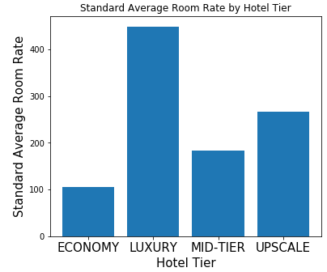
Insights
From the bar chart,it can be seen that luxury hotel has the highest room rate and that economy hotels have the lowest room rate
This can be explained by the fact that luxury hotel types have more facilities and accomodation than the other hotel tiers.Furthermore many of the guest that stays in this hotels are here for vacation and on business trip thus they would prefer to stay in luxury hotels more

Slide 18
Insights
This pie chart shows that most of the revenue per available rooms are from The luxury hotel tier,While the lowest is from the Economy Hotel Tier.
This is mainly because luxury hotel have world class facilities and accomodation.To continuously supply this excellent class service,The hotel will charge more for its guest than other hotel tiers.

Slide 19
Conclusion
Overall,The hotel market in Singapore is continuing its positive trend upwards despite some setbacks
This is due to the fact that more world class hotels are being built in Singapore to keep up the demands of incoming tourist
Singapore’s world class standards and its great hotel market has caused its revenue to be a contributing factor to Singapore’s Economy.This is evident by Hotel room revenue in 2018 being S$3.998 billion.

Slide 20
Dataset 3:(Air Cargo Discharged - Total by Region and Selected Country of Origin)
This dataset contains information about the Air Cargo Discharged from Changi Airport
This Dataset contains 5 columns which are (month,level_1,level_2,level_3,value)

Slide 21
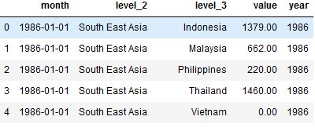
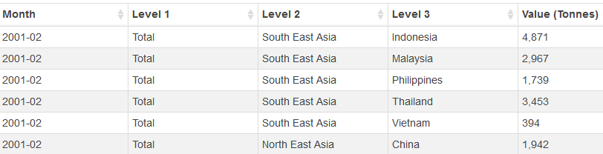
Data Manipulation
This dataset contained the data as months which is a large amount of values so i turned into years for ease of data analysis using the pd.to_datetime method
I dropped one of the columns (‘level_1’) which consist of the same value

Slide 22
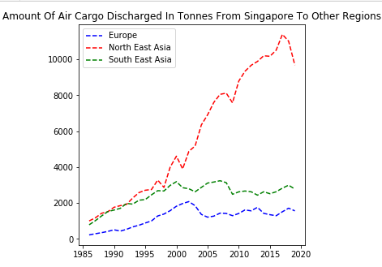
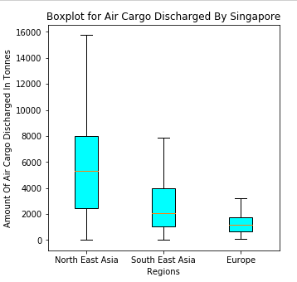
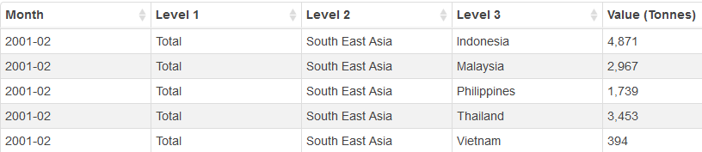
Processes
Planning of the data analysis of the Dataset and deciding on the graph that would best represent the Dataset.
Usage of Pandas Library to read the file and extract useful information on the dataset
Usage of the Matplotlib Library to generate the graphs

Slide 23
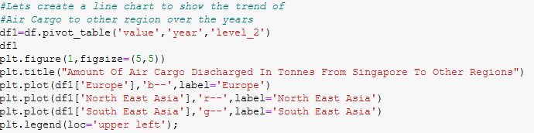
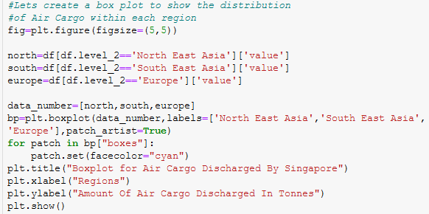
Code used

Slide 24
Insights
From the line chart,it can be seen that air cargo discharged from Singapore to North East Asia has been increasing significantly.However air cargo discharged from Singapore to South East Asia and Europe has increased and it has stagnated starting from 2010
The box-plot shows that the Air Cargo Discharged to North East Asia is the highest and Most Spread out compared to Other Regions

Slide 25
Conclusion of Dataset 3
Overall,it can be concluded that North East Asia is the region where the most air cargo has been discharged from Singapore compared to other regions
This is because north east asia consist of China,which is a major trading partner of Singapore and have signed many important trade deals such as China-Singapore Trade Agreement,Thus explaining the increase in Air cargo discharged from singapore to this region in particular
Furthermore,It can be seen that the Amount Of Air Cargo Discharged from Singapore has been increasing,this is due to the fact that Singapore has continuously upgraded its air cargo fleet through Singapore Airlines.This has caused SIA to be named the best cargo carrier in asia

Slide 26
Thank You

